Slide 1
Using Xilinx Vivado for SDR Development
Laurence Barker G8NJJ

Slide 2
Contents
What’s in an HF SDR FPGA?
Creating a DSP TX design with Vivado IP Integrator
Debugging DSP TX using the simulator
Running On Hardware

Slide 3
What’s my ambition?
I want to understand HF SDR algorithms
I want a radio where I have written some of the code
I want to re-discover FPGA design after 25 years
This will take several years… I’m only 3 years in
I’ve done nothing original – just learned from others
Pavel Demin (Red Pitaya)
Phil, VK6APH and Warren Pratt, NR0V and others (HPSDR)
Notes:
The last bit may belong on a different slide

Slide 4
What’s in an HF SDR project?
Powersdr
pihpsdr
Notes:
At the left – conventional broadband RF
Data conversion covering the whole HF band. 60MHz b/w 14 or 16 bits
Then PC processing with the user interface. Many choices of app available. This is where most of the complexity is!
And if you want it you can still have a conventional front panel with tuning knob, controls and pushbuttons

Slide 5
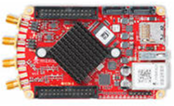
One way to make this – Red Pitaya
Image copyright Red Pitaya d.d
Notes:
Lots of ways to make SDR.
One way – The RedPitaya
Uses ZynqSystem on Chip FPGA combining ARM processing & FPGA

Slide 6
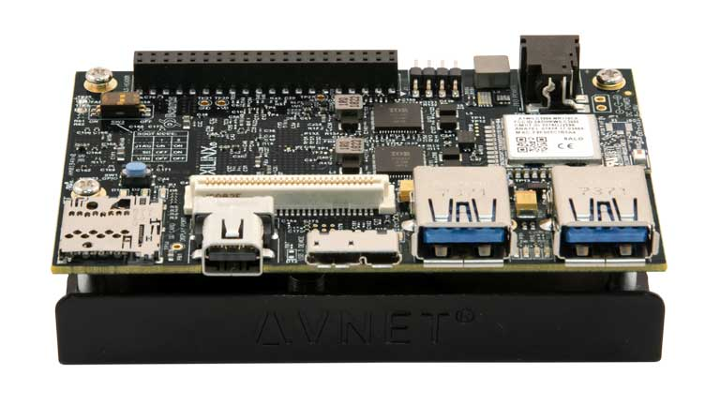
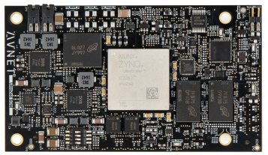
Another Way – System on Module
Ultra96
UltraZed-EG
Images copyright Avnet Inc
Notes:
Another way – think of it as a single board computer connected to ADC/DAC

Slide 7
What’s in a System on Chip FPGA?
C, Python, …
VHDL, Verilog…
Two halves, one chip
Processing System (PS)
ARM processors
SBC-like I/O
SDRAM interface
Programmable Logic (PL)
Configurable Logic
DSP Slices
Dual port RAMs
Programmed differently!
Processor I/O
USB, DisplayPort,
Serial,
I2C,
GPIO…
Processing System
Programmable Logic
2/4 core ARM
SelectIO
For ADC, DAC, T/R, Codec…
Logic
Memory
DSP
ZU3EG: quad core ARM;
2.3M equivalent gates +950KB RAM + 360 DSP slices
Notes:
Lots of different devices available from both Intel and Xilinx
Xilinx Zynq & Ultrascale+ Zynq families

Slide 8
Overall Design Flow - Xilinx
“normal” GCC / GDB
Exe file
Your Design
SDR App
For an SBC - This might be done for you
Linux Operating System
root fs, FSBL
SD Card
petalinux-create
petalinux-build
FPGA
Vivado
.xsa file
petalinux-package
boot.bin
Image copyright Avnet Inc
Notes:
3 quite different technologies
“app” uses conventional software tools eg Gnu C compiler
Linux – you need a kernel, drivers and a root filesystem. Xilinx Petalinux tools will help create these (and SBC supplier may have helped too)
FPGA – Vivado creates the FPGA design file. (simple merge process with the petalinux boot loader too)
Everything goes on an SD card into your SBC

Slide 9
3 ways to Design the FPGA
Write VHDL or Verilog code by hand
A lot of effort
Use someone else’s IP, and join it together
Re-using good designs
This is what we will be doing today
Synthesis from a higher level language (eg C, python, MATLAB, GNU radio)
Could be the way of the future?
Eg port bits of Warren Pratt’s WDSP?
IP = Intellectual Property

Slide 10
HF SDR: What needs to happen the FPGA
TX is the same thing, backwards
14.205MHz
5KHz
PC interface
Low pass Filter
2560
Inphase
14.205MHz
ADC
Mixer
Low Pass Filter
2560
Quadrature
sin, cos
0 ± 24KHz
Digital Oscillator
14.200MHz
Decimate (Divide clock) by 2560
Sample rate 48KHz
(or multiple)
Sample rate 122.88MHz
Notes:
Quite a simple process
Mix the signal with sin, cosine of local oscillator
Filter and reduce the sample rate
Send data to PC

Slide 11
The DSP Blocks needed
TX is the same thing, backwards
CIC filter
FIR Filter
Inphase
FIFO
Memory
(First in, First Out)
ADC
Complex Multiplier
Decimate by 384
Decimate by 8
CIC filter
FIR Filter
Quadrature
sin, cos
Low pass filter 0-22KHz
Direct Digital Synthesiser
Decimate (Divide clock) by 2560
Sample rate 48KHz
(or multiple)
Sample rate 122.88MHz
Notes:
Quite a simple process
Mix the signal with sin, cosine of local oscillator
Filter and reduce the sample rate
Send data to PC

Slide 12
Useful Information
Please read these first!
Xilinx UG995: Designing IP Subsystems Using IP Integrator (Tutorial)
Xilinx UG994: Designing IP Systems Using IP Integrator (User Guide)
Other useful information sources
Every IP core has a datasheet
Xilinx PG085 AXI4-Stream Infrastructure IP Suite v2.2 (data sheet)
“The ZYNQ Book” by Louise Crockett, Ross Elliot, Martin Enderwitz & Robert Stewart

Slide 13
Downloading & Installing Vivado
Webpack edition – free to use, for smaller devices
2-3 releases per year – current is 2019.2
Your design belongs to that version, until you upgrade
You could need 2 or 3 versions installed, ~50GByte each!
Decide how/where to run
Vivado – x64 Windows PC
petalinux tools – in a ubuntu VM on the PC
Create a Xilinx account, then
Download & run Xilinx Unified Installer 2019.2: Windows Self Extracting Web Installer then select Vitis, and no licence manager

Slide 14
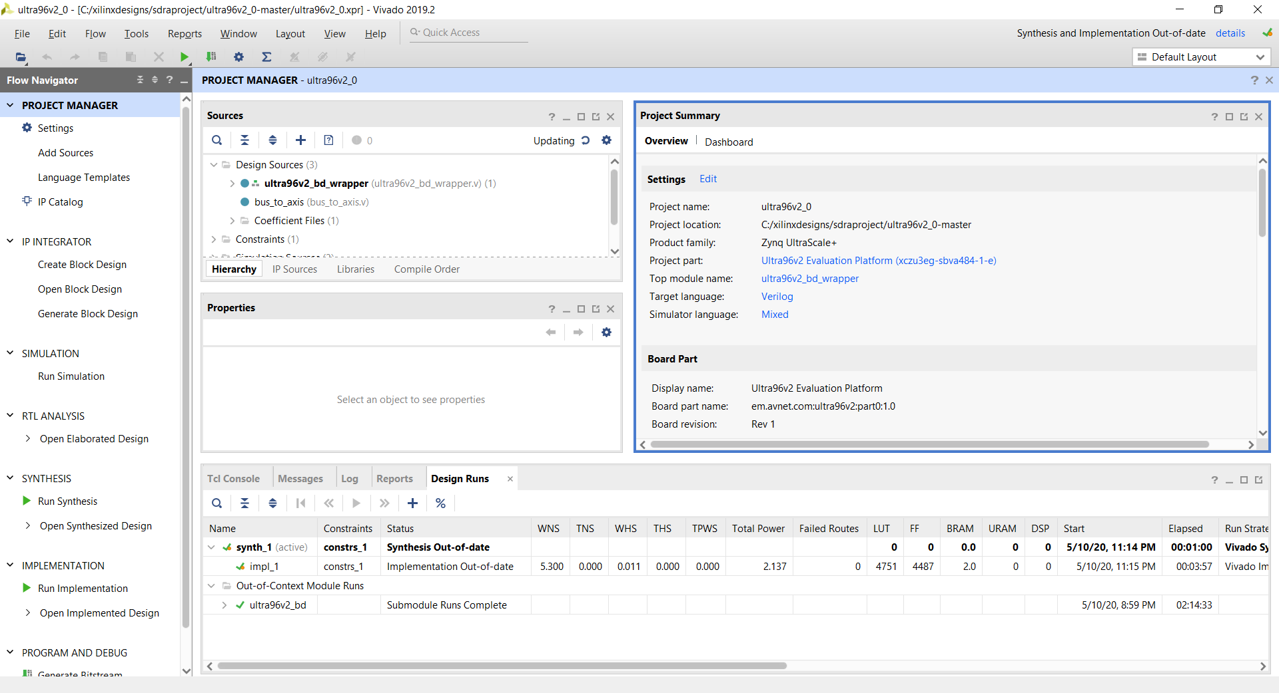
Vivado Main Screen
Source files
Project information
Main Design Steps

Slide 15
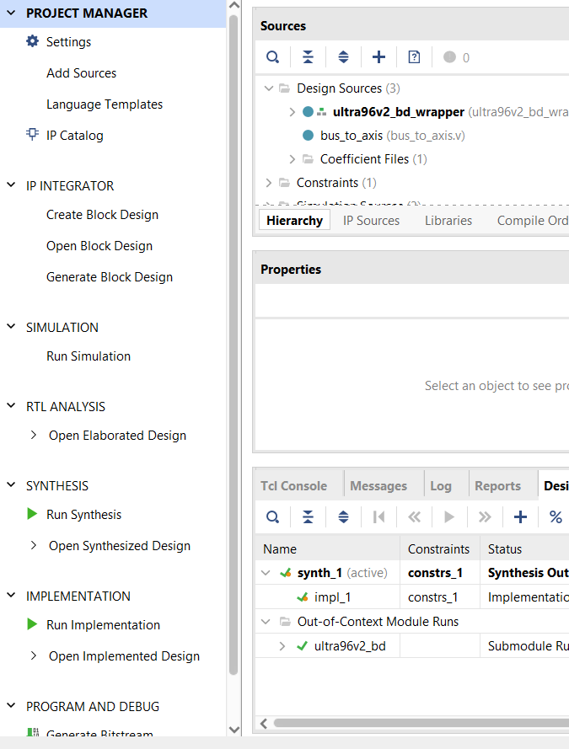
IP Integrator
We will be using the IP Integrator in Vivado
Xilinx creates the IP
We join it together in a block diagram
3 reasons why that’s good:
It’s quick to learn
The code works
Many others in the design team can understand the diagram

Slide 16
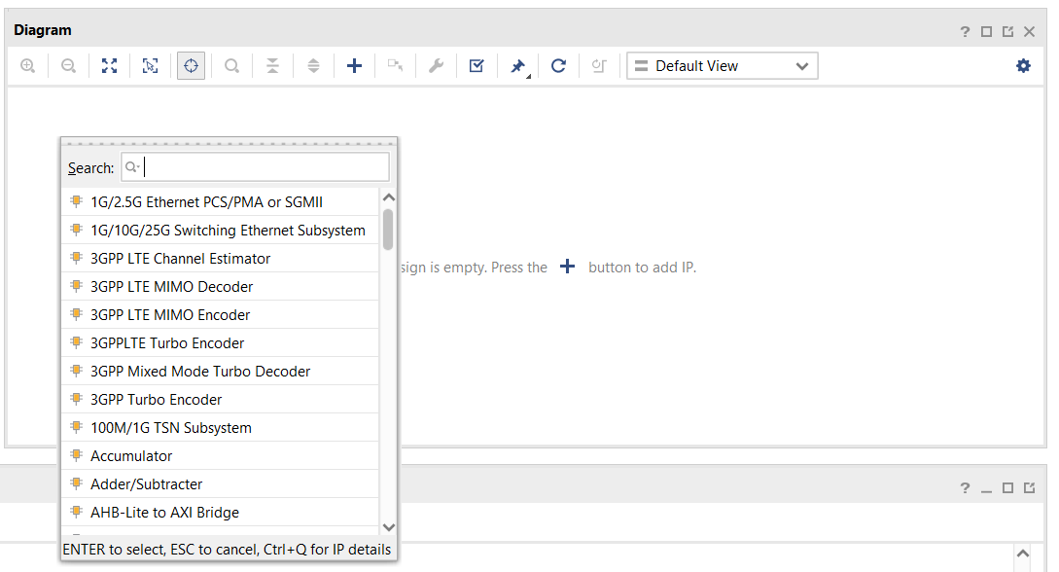
Starting an IP Integrator design
Click “Create Block Design”
You get a design canvas
Just like a schematic editor
Add IP blocks (predesigned cores)
Add modules (Verilog or VHDL code)
Create ports for input and output
Join together with wires

Slide 17
Intellectual Property (IP) Cores available
Around 180 IP cores available
Processors
DSP
Video, display drivers
Interfaces
Infrastructure
Standardised interfaces
AXI4-Bus
AXI4-Stream
DSP includes:
Complex Multiplier
DDS Compiler
CIC Compiler
FIR Compiler
2G/3G/4G cores
Fast Fourier Transform
Memory, FIFO

Slide 18
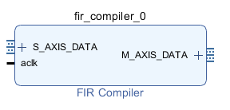
Look at the I/O for a “typical” FIR filter block
Master (output) data
Slave (input) data
Input: a stream of input samples
Output: a stream of output samples
It decimates (reduces) the data rate
The data in and out are AXI4-Stream
A standard way of passing streams of samples
This makes it really easy
Join the blocks, and they sort out the data rates
You need to understand it a bit!
Clock

Slide 19
AXI4-Stream – “Glue” for all the DSP blocks
A stream of data from one source (master) to one destination (slave)
tdata: A “pipe” of samples, N bytes wide
tvalid: A signal from the master to say “I have data to transfer”
tready: A signal from the slave to say “I am ready to accept data”
All devices are clocked at the same speed
tready and tvalid cause the data to flow when ready
Data transfers when both tready and tvalid are 1
Just join the blocks…
They work out when to transfer data

Slide 20
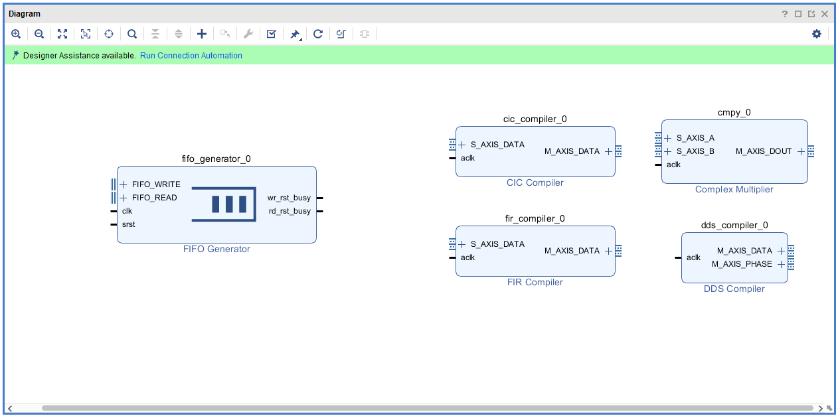
Add the DSP blocks that we need
Double click them to get the configuration page

Slide 21
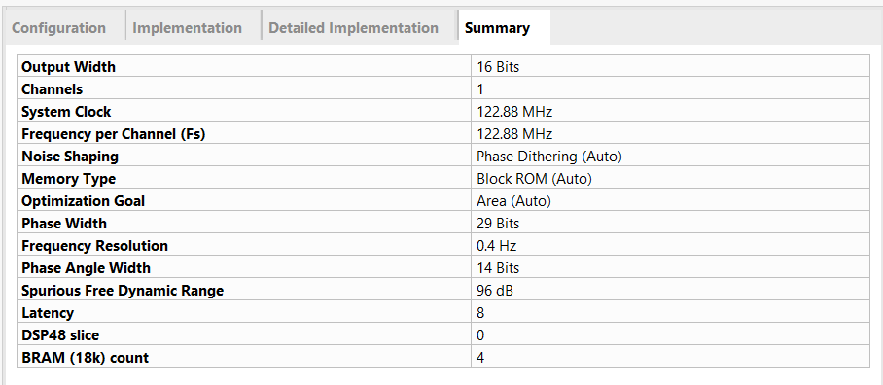
Local Oscillator DDS Configuration(1)
Double click a block to edit its settings
The DDS has 4 pages of settings!
Configuration Tab
System Clock 122.88MHz
Spurious free dynamic range 96dB
Frequency resolution 0.4Hz
Implementation Tab
Set to streaming
untick “has phase out”

Slide 22
FIR Filter Datapath
The FIR filter has a slow sample rate (384KHz) & could run much faster
And it uses a lot of resources
To be efficient: we multiplex both I/Q streams through the same FIR
For this Xilinx provides the AXI4-Stream Data Width Converter¹
1: see Xilinx AXI4-Stream Infrastructure IP Suite v2.2 (PG085) p14

Slide 23
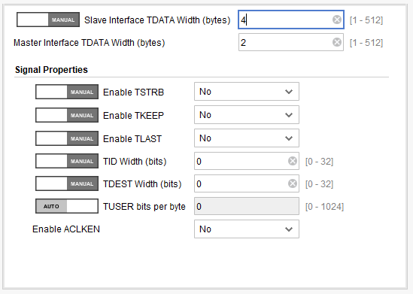
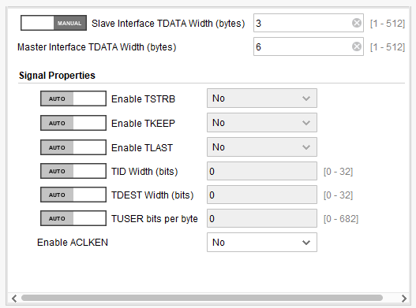
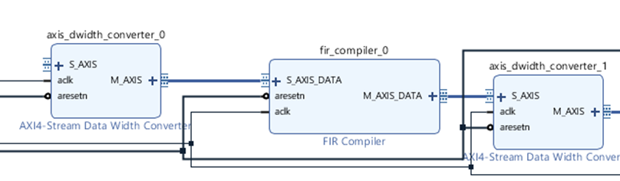
FIR Filter Datapath
Slave interface TDATA width 4 bytes
Master interface TDATA width 2 bytes
Slave interface TDATA width 3 bytes
Master interface TDATA width 6 bytes
1: see Xilinx AXI4-Stream Infrastructure IP Suite v2.2 (PG085) p14

Slide 24
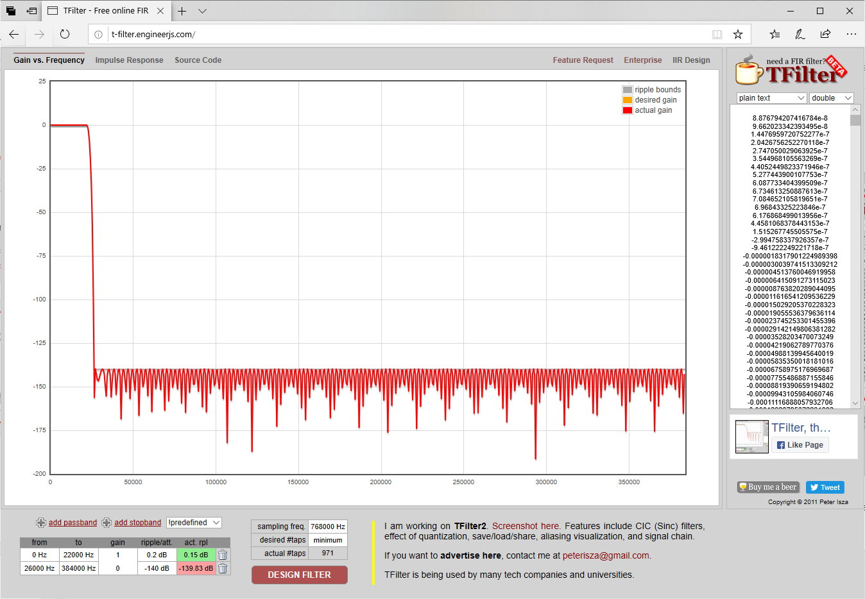
FIR Filter – calculate the coefficients
We need to design a filter
Run tfilter¹ online
Passband 0-22KHz, 0.2dB ripple
Stopband 24-384KHz, -140dB
Copy out the coefficients as double precision
Use a spreadsheet to change format to .coe²
1: http://t-filter.engineerjs.com/
2: https://www.xilinx.com/support/documentation/sw_manuals/xilinx11/cgn_r_coe_file_syntax.htm

Slide 25
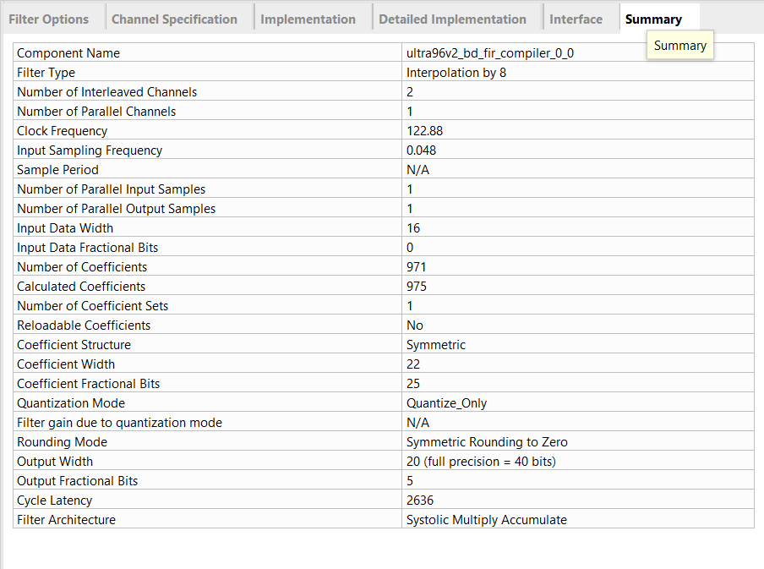
FIR Filter Configuration
Interpolating filter, by 8
2 channels
Clock frequency 122.88MHz, input rate 48KHz
Input data 16 bits, o/p data 20 bits
Coefficient width 22 bits
Output tready ticked
Filter taps in coefficient file (.coe)

Slide 26
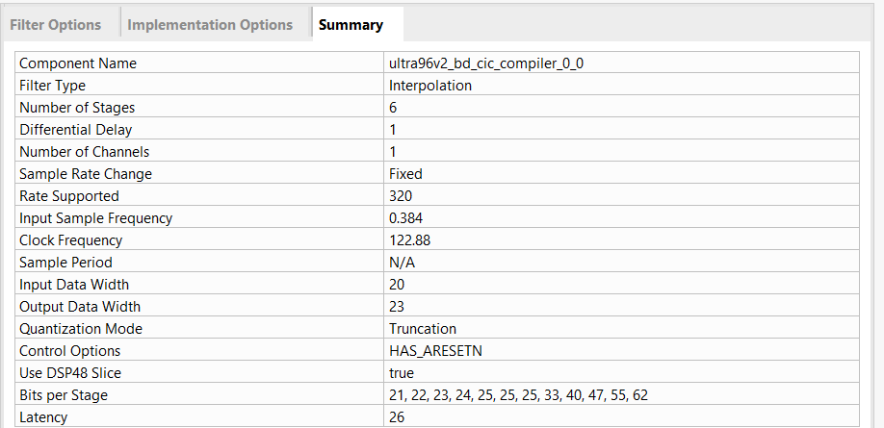
CIC Filter Configuration
We have 2 identical CIC filters
6 stages
Interpolate by 320
Input width 20 bits, output width 23 bits
Output tready ticked

Slide 27
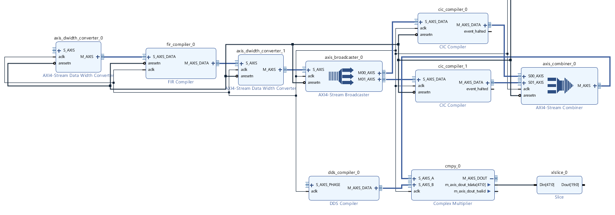
Join the blocks together… DSP finished!
Clock and reset for everything
I/Q audio in here
CIC filters
FIR filter
VFO Frequency word here
We’ve done the Maths
All Xilinx IP
We need to little “glue” to finish off
Connect DAC here
Complex multiplier
DDS

Slide 28
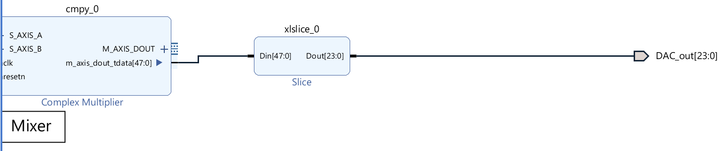
Connect the DAC
Add an output port to the schematic
Allows the signals to be I/O pins & to be accessed in the simulator
Click the + on the master axi4-stream output
Now you can connect to the tdata bus
Add a slice IP core to rip 24 bits from the 48 bit I/Q bus
Use “create port” to make this

Slide 29
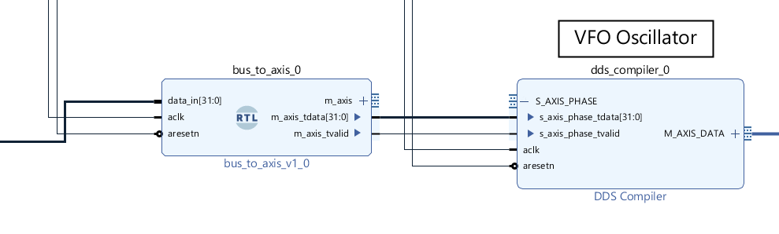
Setting the DDS Frequency
I’m going to feed in a constant value to test this
Data needs to become an axi4-stream
I’ve created “bus_to_axis” Verilog (only 48 lines)
Right click “add module” & select “bus_to_axis.v”
Double click & set “Validonchangeonly” to 0
AXI4-stream with same data value
16 bit constant bus
From a port

Slide 30
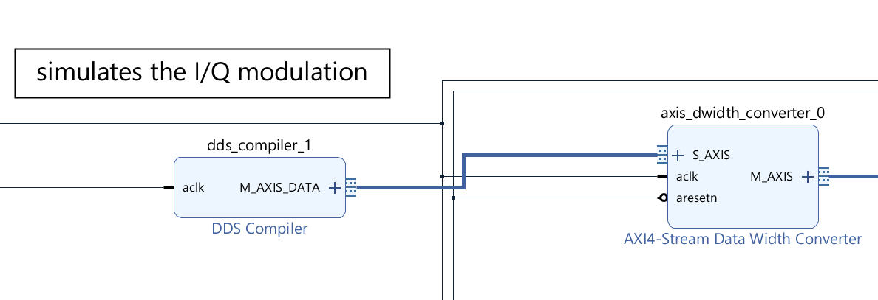
Feeding in I/Q TX Audio
Will normally come from the ARM cores, via a FIFO
Will take too long to bring a processor into this talk!
For now, just use another DDS
Set DDS properties:
Clock rate 48KHz
Output frequency fixed, 10KHz
Has output tready (v important!)

Slide 31
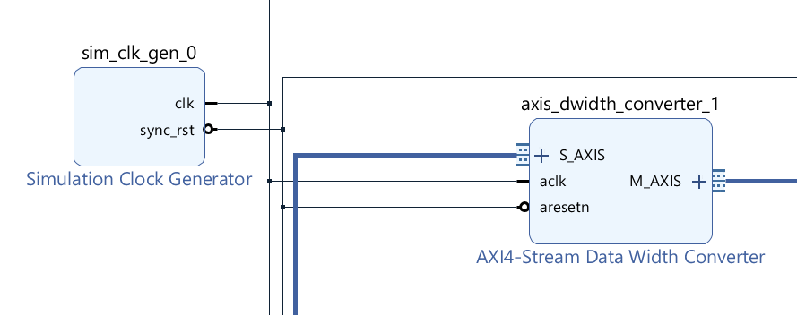
Providing clock and reset
For a hardware test – clock and reset would be external signals
You can create clock and reset in the simulator, every time
But Xilinx provides a simulation source
Provides a simulated clock and reset signal
Set its properties:
Clock frequency 122880000Hz
Reset: active low, 200 clocks

Slide 32
Now we’re ready to Simulate
Save and close the block design
Create an HDL wrapper
Select “Run Simulation”
….and almost certainly it won’t work
My approach has been: break into small sections and test each
Include debug until it is all working
Let’s break down this down into sections

Slide 33
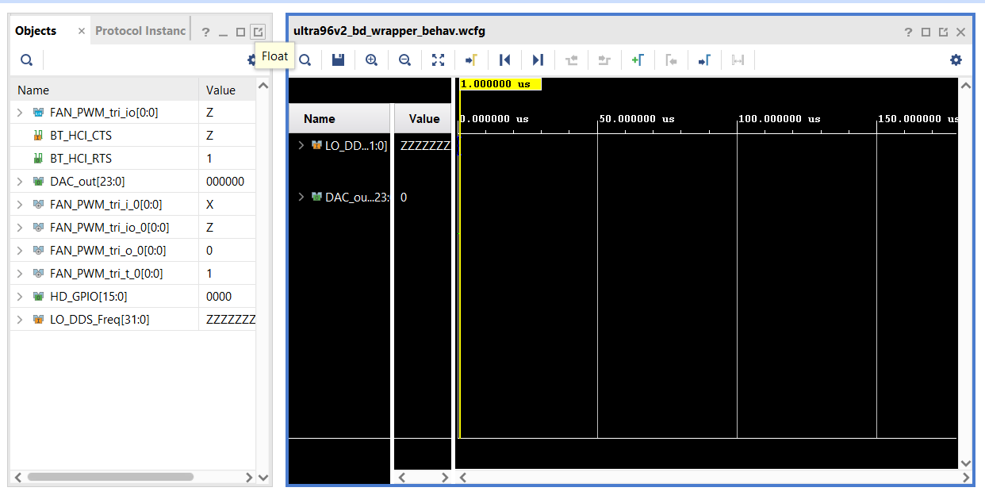
Behavioural Simulation Basics
This is how you debug – you have access to everything
To view signals, create ports on the block design
To view a signal
drag it from the list at the left
To set a value on an input
Right click and select “force constant”
To run and stop the simulator
run and pause buttons on main toolbar

Slide 34
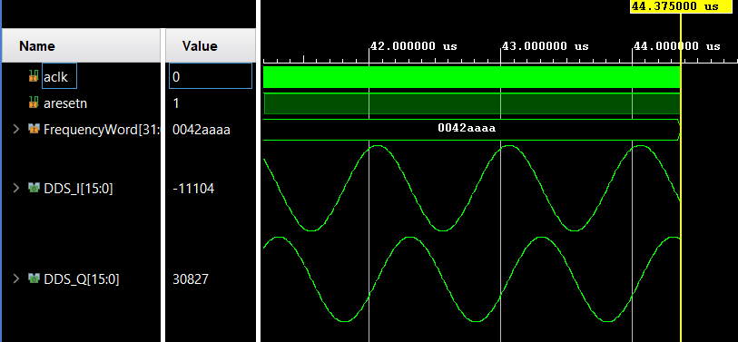
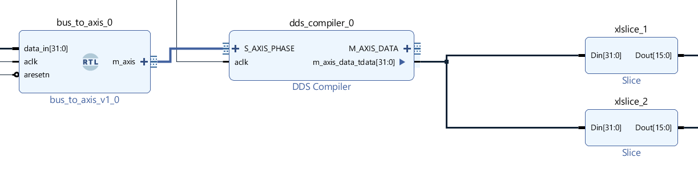
Simulating the DDS
Run “behavioural simulation”
Drag your two 16 bit buses onto screen
Set waveform style to analogue
Set radix to signed decimal
Set frequency word to 0042AAAA
Start with just the DDS, & Verilog module
Route its outputs to ports
(use “slice” to split into 2 16 bit buses)
And we get 1MHz I, Q sinewaves

Slide 35
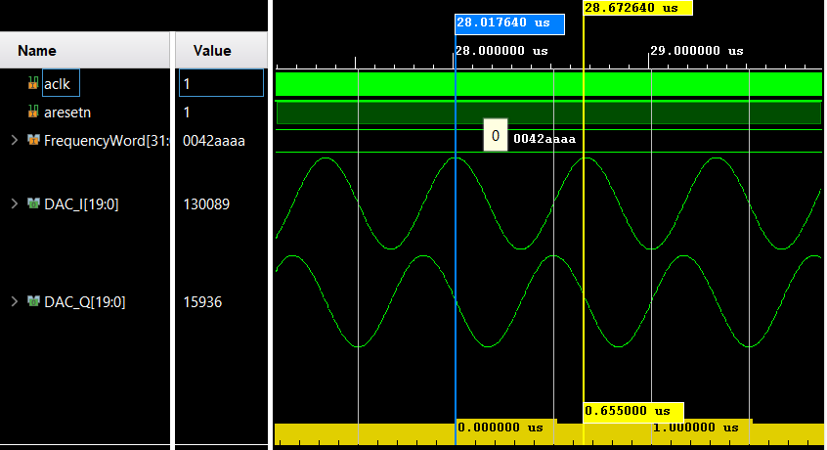
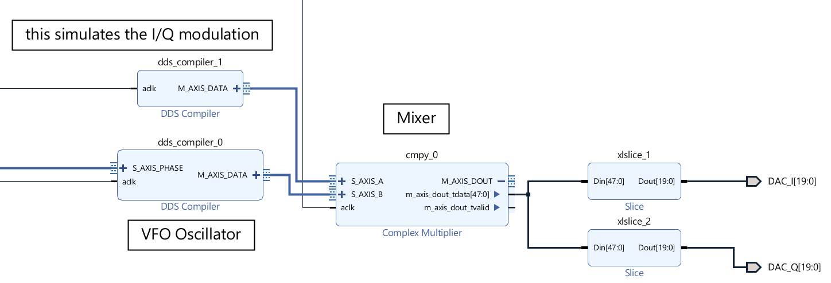
Add the complex multiplier
Connect complex multiplier to DDS
Add another DDS, constant frequency 0.5MHz
Connect the ports to complex output
And we get 1.5MHz I, Q sinewaves

Slide 36
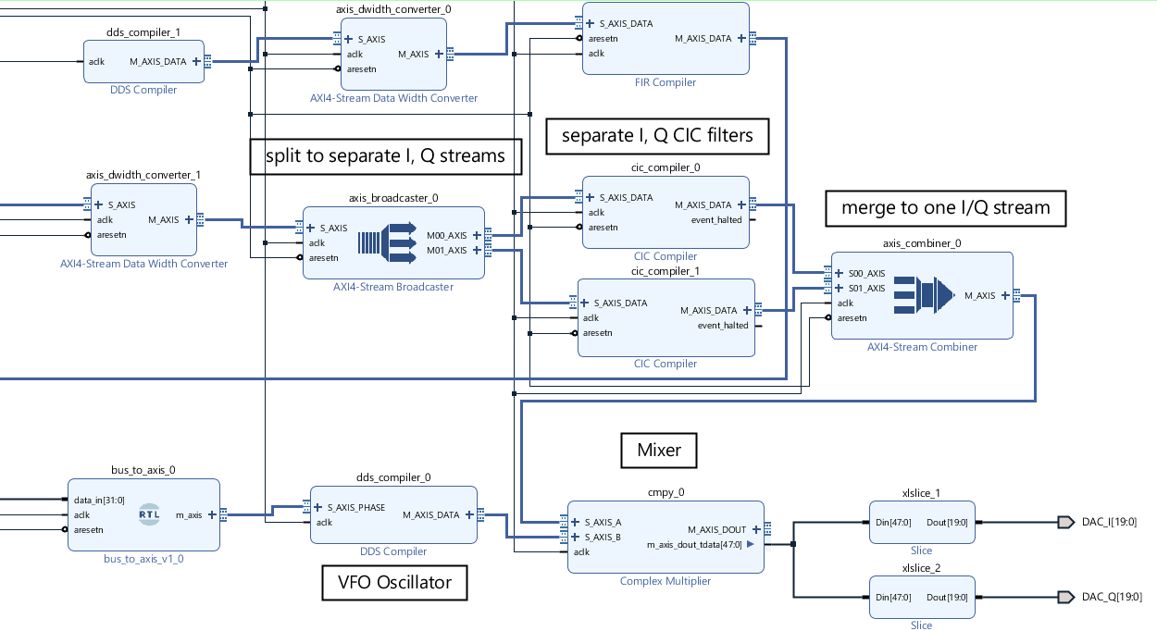
Add the Filter Chain
Moved the I/Q test DDS to here
Now set to 10KHz
Break to smaller chunks or add debug outputs as needed

Slide 37
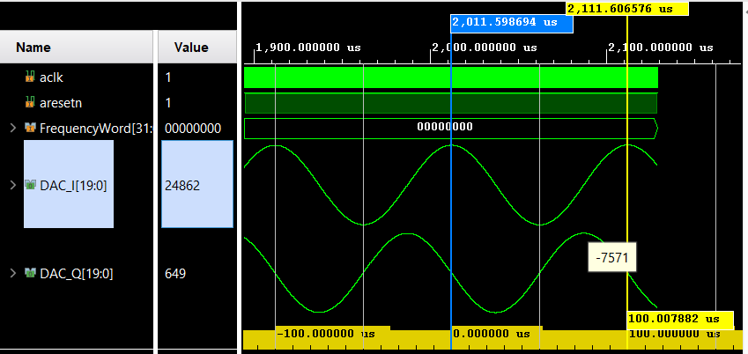
Simulating the filter chain
First – simulate to see the modulation signal
Set VFO DDS to 0Hz
Be patient…
The I/Q filters take ~2ms to settle
Several minutes on my PC!
We see 10KHz sinewaves
As expected

Slide 38
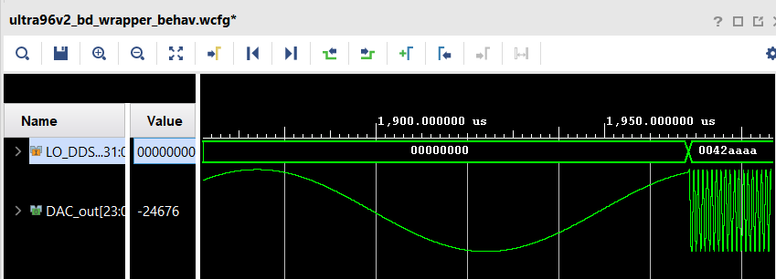
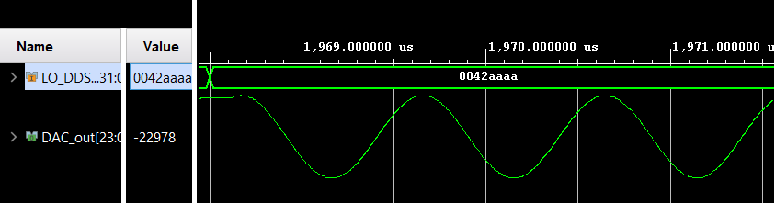
And the modulated output
Pause the simulation
Force DDS frequency word to 0x0042AAAA (1MHz)
Continue the simulation
Now we see the modulated carrier
1.01MHz
Zoomed in – 1MHz sinewave

Slide 39
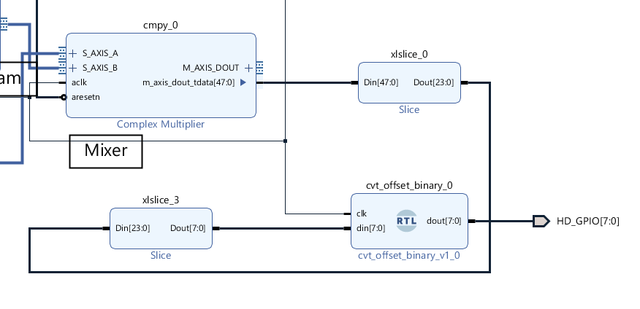
That’s your TX - connect to a DAC?
Convert the output word to binary
I’ve used a tiny bit of Verilog
(You only need to invert the top bit)
Connected 8 bits out to an R-2R resistor ladder “DAC”
We need a real clock and reset
Can get that from the ARM cores in my Xilinx device
Use a PLL clock multiplier to get 122.88MHz
(OK for testing, not for a radio!)
Assign the pins, then generate bitstream
Use JTAG to download to the FPGA

Slide 40
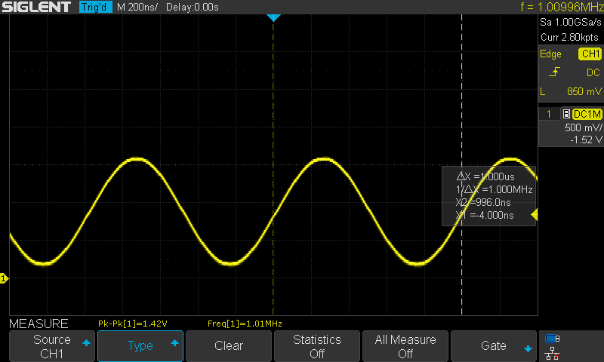
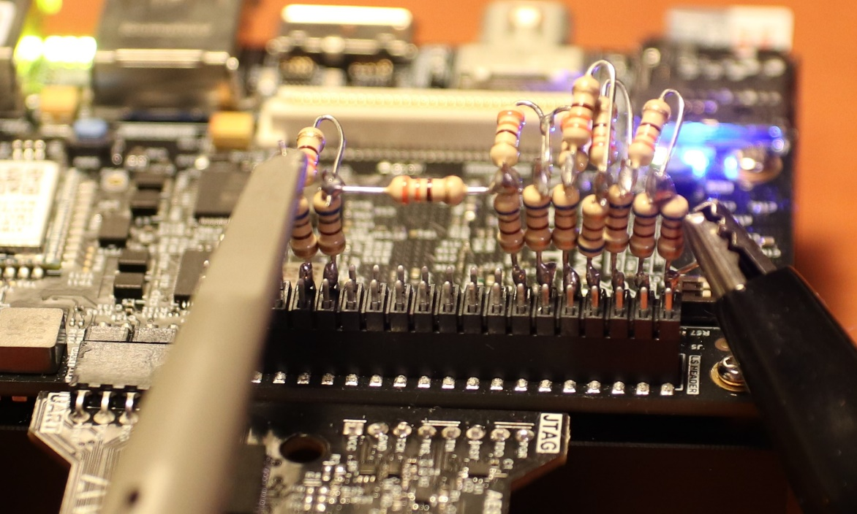
And here is the output waveform
Not bad from a DAC made from resistors!
1.01MHz, as expected

Slide 41
Summary
We’ve scratched the surface, at least
Made a simple TX
Simulated it
And run it on an FPGA
Adding a receiver is the same thing, but the other way round
Still need “glue” to connect to the processors
And I still need to master the Linux bit!

